Slide 1

COPYRIGHT INFORMATION DOCUMENT AND QUOTATION
LEXTRIA RESEARCH
Addressed to | Mr. Soumyakanta
Dated | 24/09/2026
Quotation Prepared by | Adv. Pranav Bhat
Contact details | 9035685434
Email | an.astraea@gmail.com / pranavbhat334@gmail.com
*Details mentioned here are for illustration purpose only
1

Slide 2








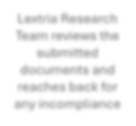
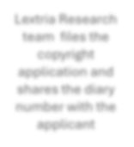
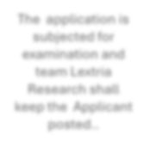

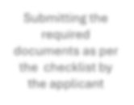
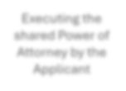







COPYRIGHT INFORMATION DOCUMENT
LEXTRIA RESEARCH
STEPS FOLLOWED BY LEXTRIA RESEARCH TO FILE A COPYRIGHT APPLICATION
STEP 1
STEP 2
STEP 3
STEP 4
STEP 5
STEP 6
Lextria Research Team reviews the submitted documents and reaches back for any incompliance
Lextria Research team files the copyright application and shares the diary number with the applicant
The application is subjected for examination and team Lextria Research shall keep the Applicant posted..
Receiving the checklist from the team Lextria Research
Submitting the required documents as per the checklist by the applicant
Executing the shared Power of Attorney by the Applicant
*Details mentioned here are for illustration purpose only
1

Slide 3
CHECKLIST AND TESTS FOR SELECTING A COPYRIGHT
LEXTRIA RESEARCH
SL NO. | CATEGORY | TYPE OF WORK
1 | Literary works | Books, novels, stories, articles, and lectures
2 | Musical works | Songs, choruses, and compositions
3 | Dramatic works | Plays, operas, musicals, screenplays, TV scripts, and dance choreography
4 | Artistic works | Paintings, photographs, cartoons, drawings, and sculptures
5 | Cinematographic works | Movies, video films, and film strips
6 | Sound recordings | Recordings of sounds, songs, and audiobooks
7 | Architectural works | Designs for buildings
8 | Software | Computer programs and video games
*Details mentioned here are for illustration purpose only
2

Slide 4










COPYRIGHT CYCLE - EXEMPLARY SCENARIO:
LEXTRIA RESEARCH
30 days Mandatory Waiting Period
30 days
ASAP
30 days
ASAP
1 day
ASAP
REGISTRATION
Filing of
Application
Formality Check
Reply to Formality Check
Examination
Discrepancy
Reply
Hearing
Hearing submission
Note: On an average it takes about 3-6 months for an application to reach the logical end

Slide 5
SOME Keywords
LEXTRIA
RESEARCH
APPLICANT
INVENTOR
Applicant may be a Legal person or a Inventor should always be a natural person, natural person, usually owner of the work who has created the work
PUBLISHER
DIARY NUMBER
Person who take the work to the masses and
A refernce number given by the Copyright Office
DISCREPENCY
HEARING
It is a first office, and
communication
from
patent
It is an opportunity to defend the application via placing oral arguments, and it shall be the final stage
includes
certain
objections
observed by the patent office and to be complied with in 6 months in writing
*Details mentioned here are for illustration purpose only
4

Slide 6
Quotation
LEXTRIA RESEARCH
Service | Item | Official Fee | Professional Fee | Total Fee
 | Filing the work of
 | copyright, filing response
Filing of copyright application in India | to the objection, attending hearing, and | 500 | 7500 | 8000
 | submission of final reply
 | post hearing
Payment shall be made stage wise, and if the mark is granted without going to next stage, payment for further stages is not necessary. Stamp duty, notary, and bank charges will be communicated separately.
*Details mentioned here are for illustration purpose only
4

